Slide 1
PRESENTATION ON Academic Scheduling
MADE BY:- Charlie Gandhi,Harshit Sharma, Tarun Handuja
(2814047, 2814025, 2814029)
BTECH CSE 4th year(A2)

Slide 2
ABSTRACT
THE TITLE OF THE PROJECT IS “Dashboard For E-Training.”
THE TECHNOLOGIES USED ARE MONGO DB, EXPRESS JS, ANGULAR JS, NODE JS.
MONGO, EXPRESS, NODE ARE USED AT BACKEND WHEREAS ANGULAR IS USED FOR FRONTEND.
IN THE PROJECT VIRTUAL CLASSROOM A WEBAPPLICATION IS MADE WHERE STUDENTS WHO ARE SHY TO ASK THEIR QUERIES IN CLASS CAN SIMPLY LOGIN TO THE SITE AND MARK THE REVIEWS WITHOUT SHOWING THEIR IDENTITY SO THAT THE TEACHER CAN GET TO KNOW ABOUT HOW MANY STUDENTS ARE ABLE TO UNDERSTANT WHAT IS BEING TAUGHT.

Slide 3
INTRODUCTION
IN THE PROJECT WE MADE A WEBAPPLICATION WHERE STUDENTS WHO ARE SHY TO ASK THE QUERIES CAN LOGIN THE SITE AND MAKE THE REVIEWS SO THAT THE TEACHER CAN EXPLAIN THEM AGAIN.
IN THIS PROJECT WE HAVE MADE VARIOUS MODULES BY USING DIFFERENT HTML 5 TAGS , WE HAVE USED CSS FOR THE STYLING PART , ANGULAR IS USED FOR DESIGNING AND CONNECTION, THERE ARE SIGN IN AND LOGIN PAGES BY WHICH USER CAN GET ACCESS TO THE SITE.
MONGO DB ,EXPRESS JS ,NODE JS ARE USED FOR CREATING THE DATABASE AND STORING DATA IN THE DATABASE..
IN THIS SITE THE IDENTITY OF THE STUDENT IS HIDDEN FROM OTHERS , SO THAT HE CAN ASK ABOUT THE DOBTS WITHOUT ANY FEAR.

Slide 4
MEAN Stack
MEAN is a technology which emerged in the present technical era. It is the collective stack of the frameworks of JavaScript with a non SQL database.
Thus MEAN comprises of 3 JavaScript frameworks such as:
• ExpressJs • AngularJs • NodeJx
The non SQL database which supports this technical stack is:
• MongoDB

Slide 5
Mongo DB
MongoDB MongoDB is an open-source document database and leading NoSQL database. MongoDB is written in C++.
Remarkable performance and efficiency of child acts on single platform is due to the support of the technology of MEAN.

Slide 6
Express JS
Express provides a minimal interface to build our applications. It provides us the tools that are required to build our app. It is flexible as there are numerous modules available on npm, which can be directly plugged into Express. Express was developed by TJ Holowaychuk and is maintained by the Node.js foundation and numerous open source contributors.

Slide 7
Angular JS
AngularJS is an open source web application framework. It was originally developed in 2009 by Misko Hevery and Adam Abrons. It is now maintained by Google. Its latest version is 1.4.3.
AngularJS is a powerful JavaScript based development framework to create RICH Internet Application(RIA).

Slide 8
Node JS
Node.js is a server-side platform built on Google Chrome's JavaScript Engine (V8 Engine). Node.js was developed by Ryan Dahl in 2009 and its latest version is v0.10.36. • Asynchronous and Event Driven − All APIs of Node.js library are asynchronous, that is, non-blocking.

Slide 9
LAYOUT
THE LAYOUT OF PROJECT IS AS FOLLOWS:-
1. Home Page
2. Sign Up Page
3. Login Page
4. Student Home Page
5. Teacher Home Page
6. Prepare Schedule
7. Show Schedule
8. Upload Library
9.Article Library

Slide 10
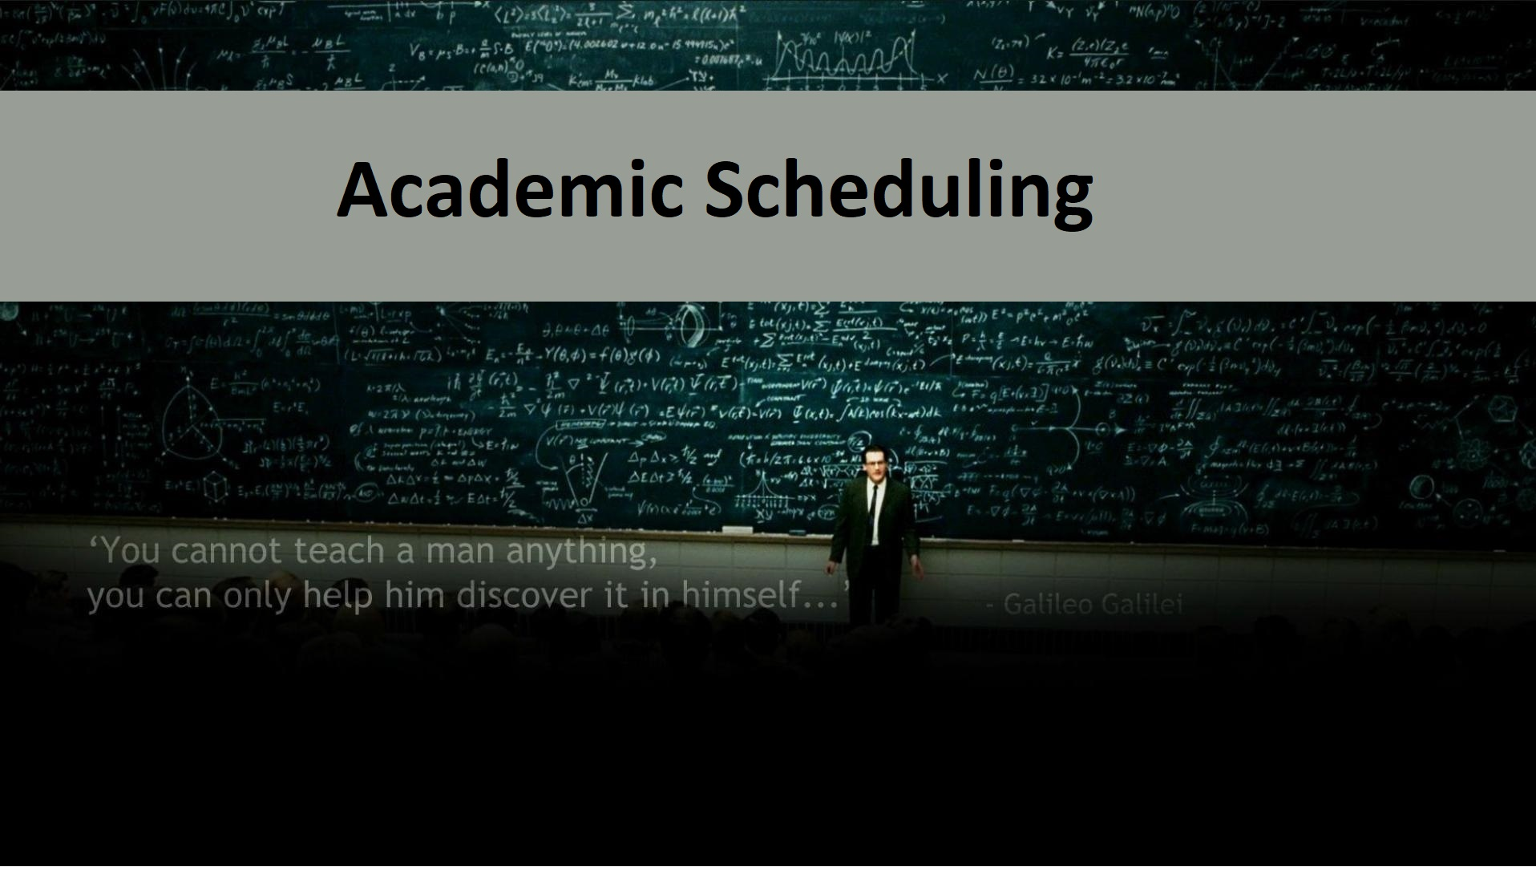
HOME PAGE

Slide 11
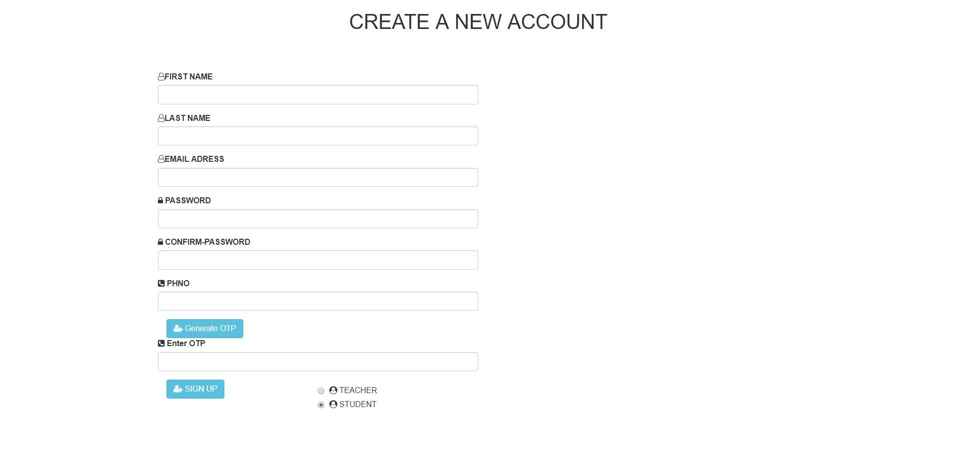
SIGN UP PAGE

Slide 12

LOGIN PAGE

Slide 13

STUDENT HOME PAGE

Slide 14
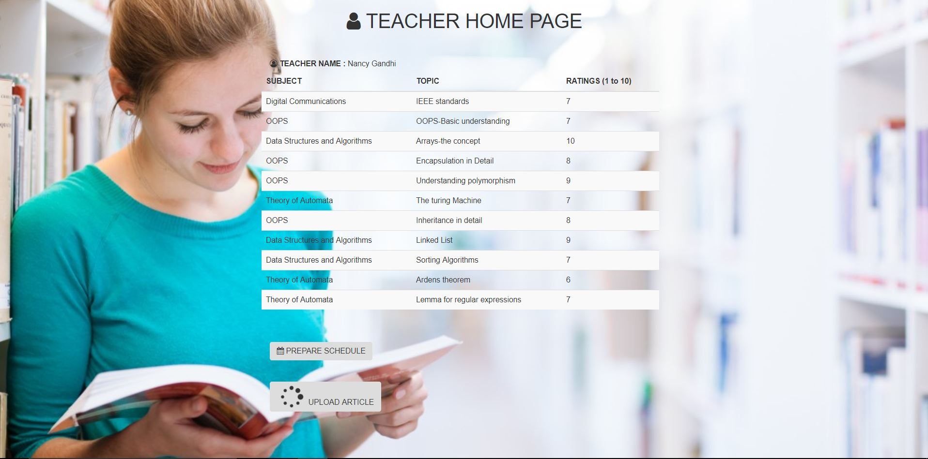
TEACHER HOME PAGE

Slide 15
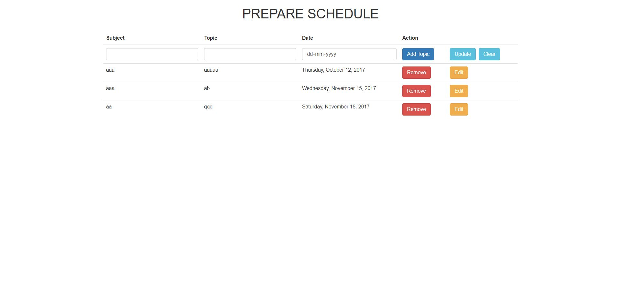
PREPARE SCHEDULE

Slide 16
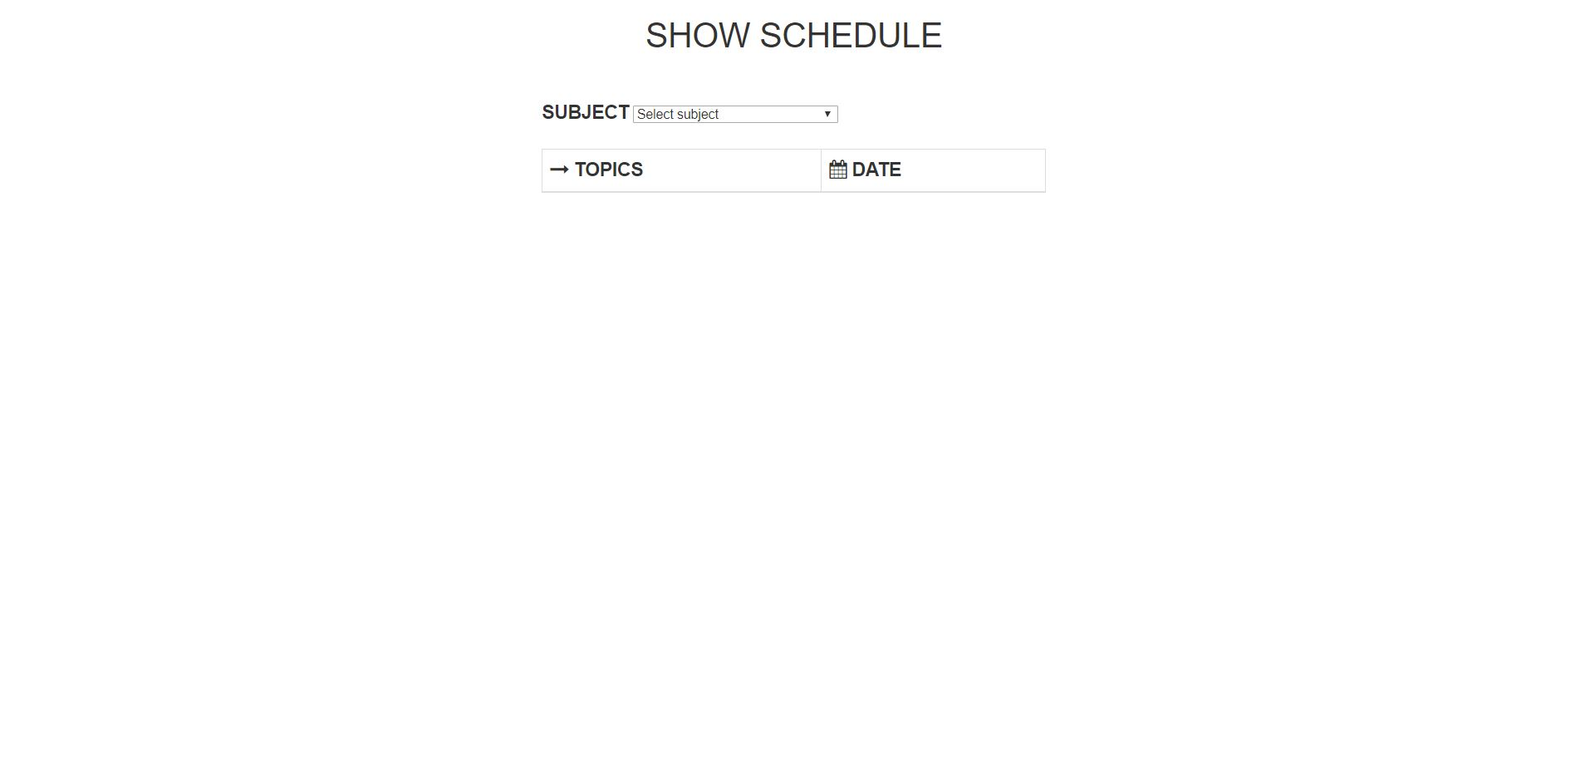
SHOW SCHEDULE

Slide 17
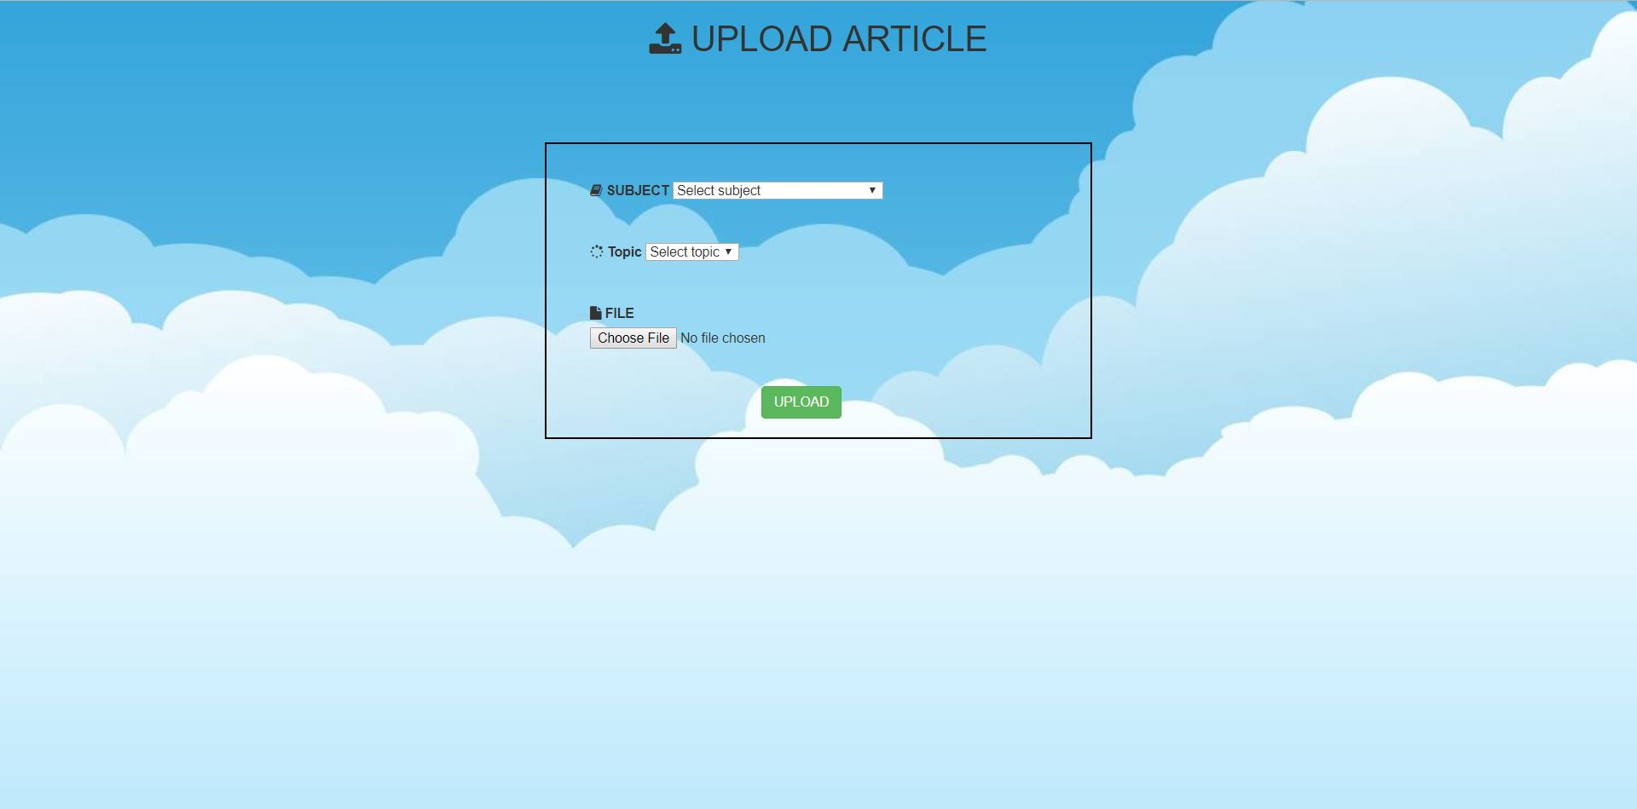
UPLOAD LIBRARY

Slide 18
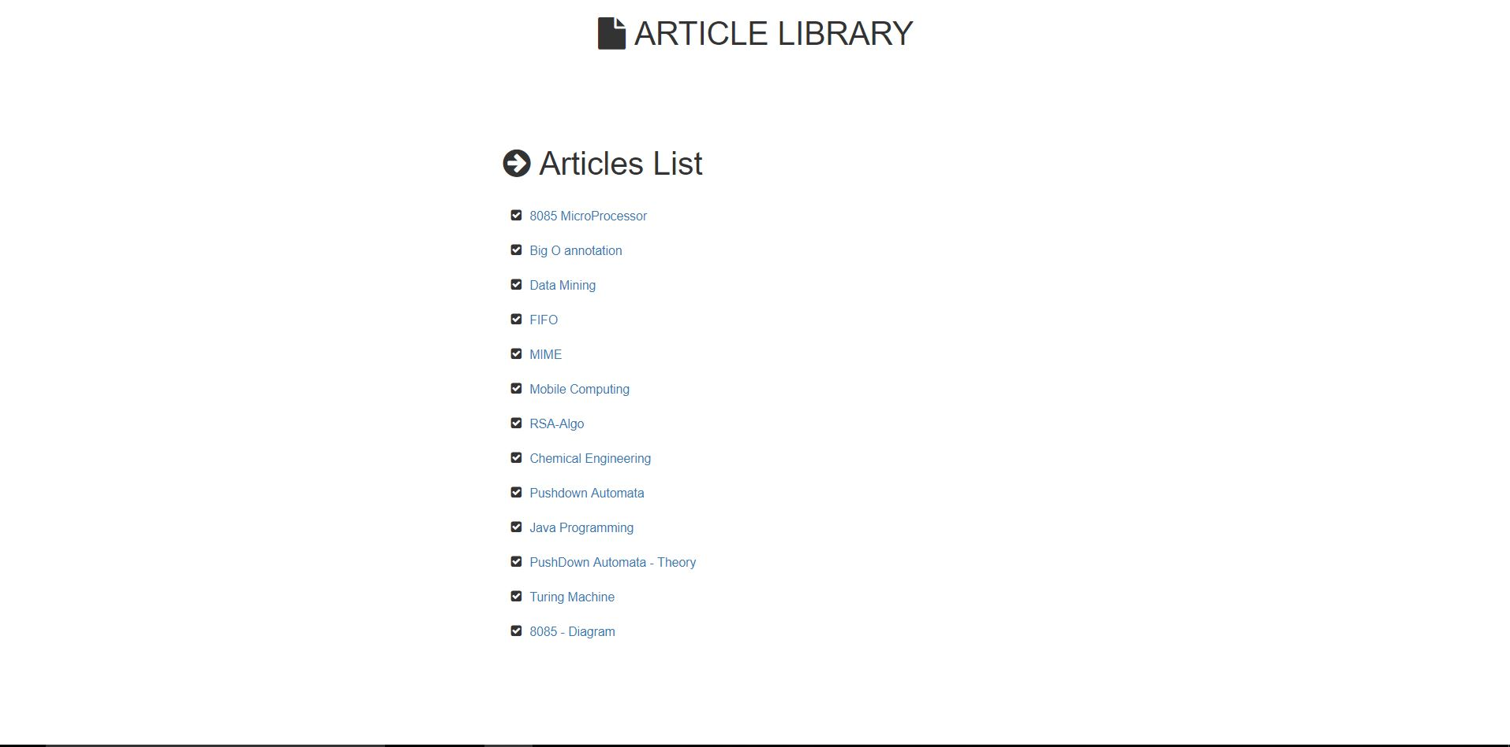
ARTICLE LIBRARY

Slide 19
CONCLUSION
IN THIS PROJECT OF Dashboard For “E-Training” STUDENTS CAN MARK THEIR QUERIES BY SIGNING UP TO THE SITE.
THE IDENTITY OF THE STUDENTS WILL BE HIDDEN FROM OTHERS, SO THAT HE IS ABLE TO ASK HIS QUERIES WITHOUT ANY FEAR.
THE TEACHER PRELISTS THE TOPICS THAT WILL BE TAUGHT IN THE CLASS NEXT DAY.
THE TEACHER CAN ALSO VIEW THE QUERIES OF THE STUDENTS SO THAT HE CAN EXPLAIN THEM AGAIN.

Slide 20
THANK YOU

